Slide 1
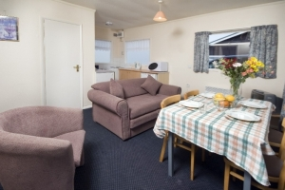
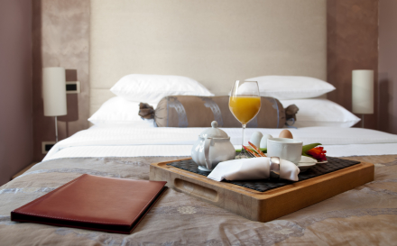
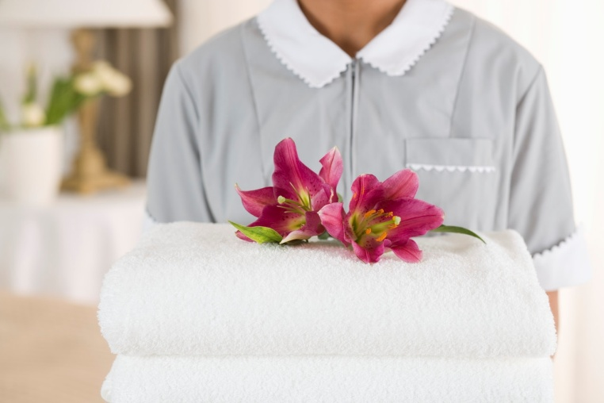
CLEAN AND PREPARE ROOMS FOR INCOMING GUESTS
D1.HHK.CL3.03
Notes:
Trainer welcomes trainees to class.

Slide 2
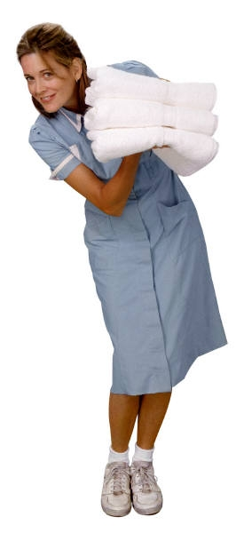
Subject Elements
This unit comprises seven Elements:
Identify the role of room attendants
Prepare for cleaning duties
Make beds
Clean bathroom
Clean room
Provide additional housekeeping services
Prepare for next shift.
Notes:
Trainer advises this Unit comprises seven Elements, as listed on this slide explaining:
• Each Element comprises a number of Performance Criteria which will be identified throughout the class and explained in detail
• Trainees can obtain more detail from their Trainee Manual
• At times the course presents advice and information about various protocols but where their workplace requirements differ to what is presented, the workplace practices and standards, as well as policies and procedures must be observed.

Slide 3
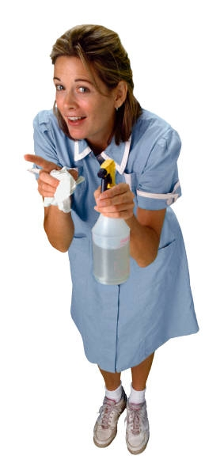
Assessment
Assessment for this unit may include:
Oral questions
Written questions
Work projects
Workplace observation of practical skills
Practical exercises
Formal report from supervisor.
Notes:
Trainer advises that assessment for this Unit may take several forms all of which are aimed at verifying they have achieved competency for the Unit as required.
Trainer indicates the methods of assessment that will be applied to them for this Unit.

Slide 4

Element 1:
Identify the role of room attendants
Notes:
Introduce topic.
Class Activity – General Discussion
Ask general questions:
What does a room attendant do?
Why is the role of a room attendant important in a hotel?

Slide 5
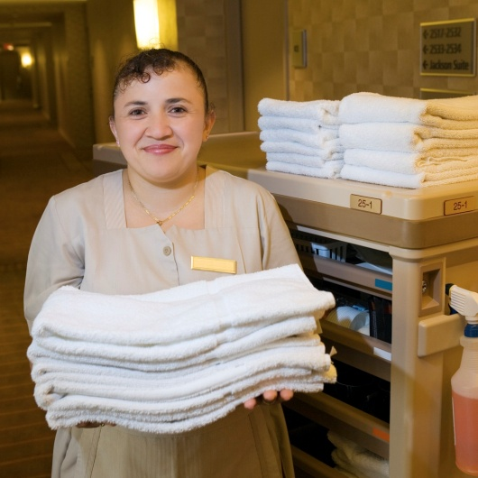
Identify the role of room attendants
Performance Criteria for this Element are:
Describe the services delivered by a room attendant
Locate the position of room attendants within the enterprise
Identify the personal characteristics required of a room attendant.
Notes:
Trainer identifies the Performance Criteria for this Element, as listed on the slide.

Slide 6
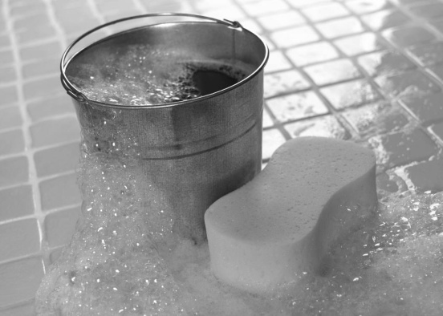
Identify the role of room attendants
Performance Criteria for this Element are:
Describe grooming and personal presentation standards for a room attendant
Interpret enterprise policies and procedures for the provision of housekeeping services
Identify and explain the role of communication in the provision of housekeeping services.
Notes:
Trainer identifies the Performance Criteria for this Element, as listed on the slide.

Slide 7
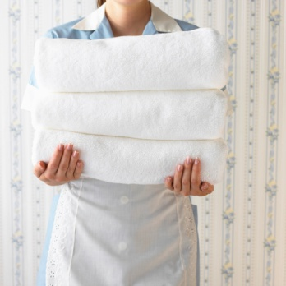
Room attendant
Room attendants are located in any tourism and hospitality business that provides accommodation to their guests.
In many hotels and resorts, more people are employed as room attendants than any other front line position.
Notes:
Class Activity – General Discussion
Why are there more room attendants employed than in other positions within a hotel?

Slide 8
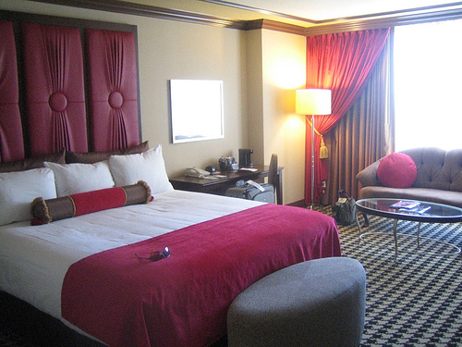
Room attendant
Their role is to facilitate the comfort of guests ensuring their ‘home away from home’ is clean, safe and presented in an appealing manner.
How can you make a room appealing?
Notes:
Class Activity – General Discussion
How can you make a room appealing?

Slide 9
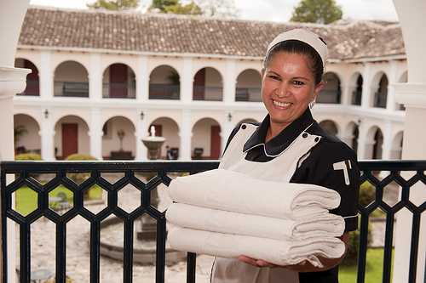
Room attendant
Whilst their primary function is to clean they must also be friendly, informative, discreet and handle any requests or problems relating to the guest room.
Notes:
Class Activity – General Discussion
How can a room attendant:
Be friendly?
Be informative – what information do they need to give the guest about the room?
Be discreet – what does this mean and how do they do it?
What are common requests?
What are common problems?

Slide 10
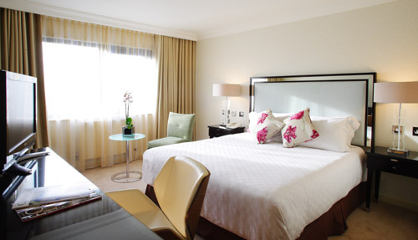
Areas of responsibility
In summary they are responsible for the:
Cleanliness of rooms
Overall appearance of rooms
Security of guest rooms
Privacy of guests.
Notes:
Class Activity – General Discussion
How can a room attendant:
Make a room clean?
Improve the appearance of a room?
Improve the security of guests and their property in a room?
Ensure the privacy of guests and their actions?

Slide 11
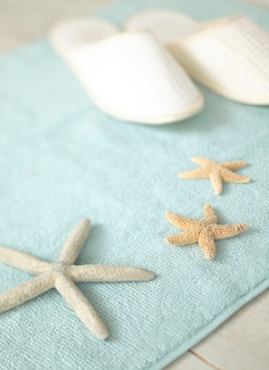
Areas of responsibility
The areas of responsibility include:
Guest Relations
Guest Safety
Cleaning
Administration and Communication.
Notes:
Guest Relations
Every employee of a hotel, including the room attendant, is expected to warmly greet guests and to be friendly and professional.
In many cases they need to work independently from other colleagues and must handle any problems that arise, without the assistance or guidance of others.
If there is a complaint about the room or its furnishings or fixtures, in many cases the room attendant must not only handle to issue, but take ownership to ensure it is resolved in a timely manner.
Guest Safety
The job description of a room attendant includes ensuring the safety and well being of guests and their property.
Cleaning
They are required to ensure all aspects of a guest room is clean and tidy.
Administration and Communication
Room attendants must ensure they understand what rooms they are to clean and in which order. Administration and communication is vital to ensure rooms are returned ‘clean’ ready for new guests.

Slide 12
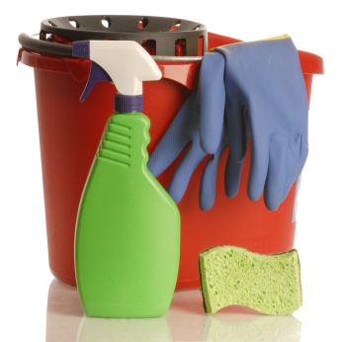
Daily activities
What are all the activities you think a room attendant does during a shift?
Prepare for work
Enter room
Clean room
Provide information to guests
Maintain storage areas and trolleys
Close shift.
Notes:
Class Activity – Group work
The trainer should get the trainees into small groups.
Allocate one of the topics in this slide to each group.
Get them to identify all the activities that would be completed in a normal day.
Get the trainees to discuss or list on board.
This activity is designed to get people thinking about the diversity of the role of room attendant. Each of these topics will be discussed in more detail over the next few slides.

Slide 13
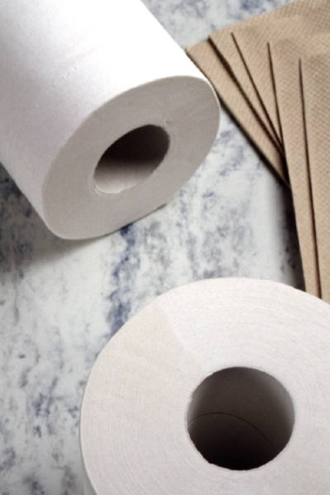
Daily activities
Prepare for work
Collect master keys
Collect daily room allocation sheets
Stock housekeeping trolleys
Stock and store supplies
Determine the order of cleaning of rooms
Identify any special requests.
Notes:
Class Activity – General Discussion
Trainer to discuss topics in slide, providing examples where possible.

Slide 14
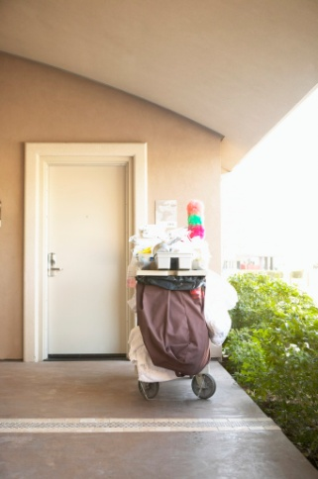
Daily activities
Enter room
Knock on door in compliance with policy
Open door securely
Place trolley in door path.
Notes:
Class Activity – General Discussion
Trainer to discuss topics in slide, providing examples where possible.

Slide 15
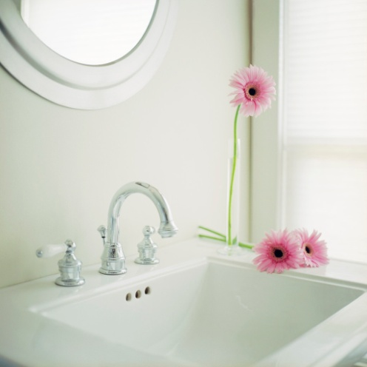
Daily activities
Clean room
Open curtains and windows for ventilation
Removing used guest amenities and rubbish
Cleaning showers, tubs, sinks and bathroom items
Changing linen and making beds
Checking for damaged linens
Inspecting rooms for safety hazards.
Notes:
Class Activity – General Discussion
Trainer to discuss topics in slide, providing examples where possible.

Slide 16
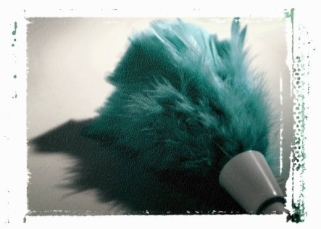
Daily activities
Clean room
Reporting lost and found articles, maintenance problems or special room problems
Dusting and cleaning room decorations, appliances and structural surfaces
Dusting, brushing, polishing and vacuuming furniture
Replenishing guest room amenities and supplies.
Notes:
Class Activity – General Discussion
Trainer to discuss topics in slide, providing examples where possible.

Slide 17
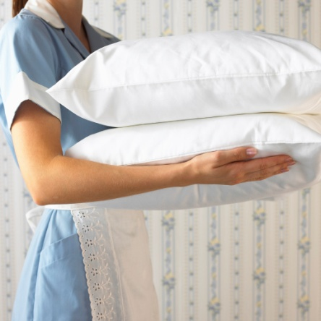
Daily activities
Clean room
Check, record and replenish mini bar
Preparing rooms for guest arrival
Responding to special guest requests
Deliver and retrieve items on loan to guests
Perform rotation cleaning duties.
Notes:
Class Activity – General Discussion
Trainer to discuss topics in slide, providing examples where possible.

Slide 18
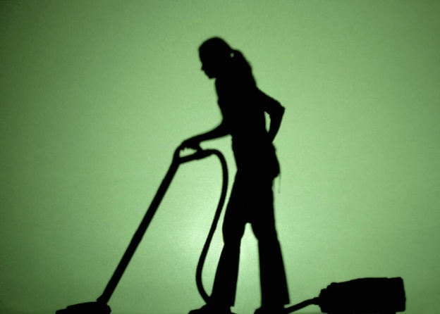
Daily activities
Clean room
Vacuuming and sweeping carpets and floors
Mopping floors as needed
Recording room status on work assignment sheets
Phone supervisor or reception updating status of room
Close door.
Notes:
Class Activity – General Discussion
Trainer to discuss topics in slide, providing examples where possible.

Slide 19
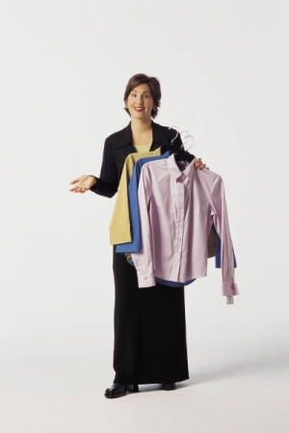
Daily activities
Provide information to guests
Listening and responding to guests’ requests or complaints
Explain room equipment and facilities
Explain and handle dry cleaning and laundry requests
Providing information to guests about:
Hotel services, facilities and other amenities
Local attractions and services
Location of places for religious worship
Prayer and fasting times
Location of prayer mats and prayer orientation.
Notes:
Class Activity – General Discussion
Trainer to discuss topics in slide, providing examples where possible.

Slide 20
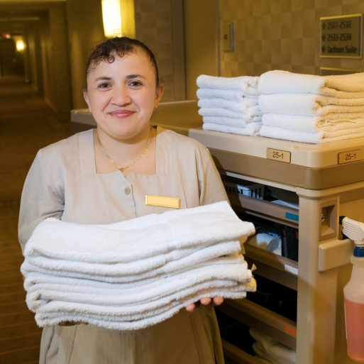
Daily activities
Maintain storage areas and trolleys
Return trolley to storage room
Empty linen from housekeeping cart
Remove soiled linen to laundry
Replenish linen and guest amenities.
Notes:
Class Activity – General Discussion
Trainer to discuss topics in slide, providing examples where possible.

Slide 21
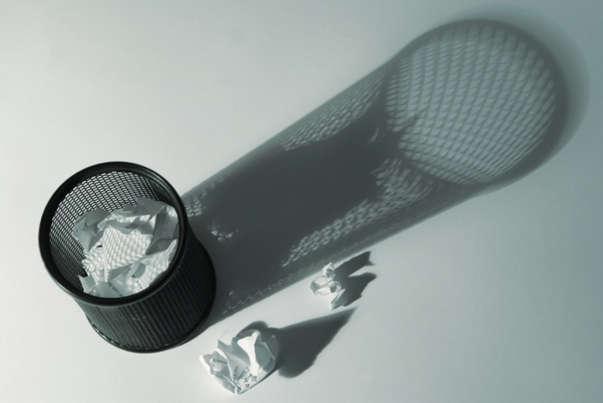
Daily activities
Maintain storage areas and trolleys
Handle lost property
Clean cleaning equipment including mops and vacuum cleaners
Remove rubbish
Clean storage room floor.
Notes:
Class Activity – General Discussion
Trainer to discuss topics in slide, providing examples where possible.

Slide 22

Daily activities
Close shift
Return work allocation sheets
Complete reports and other documentation
Return keys.
Notes:
Class Activity – General Discussion
Trainer to discuss topics in slide, providing examples where possible.

Slide 23
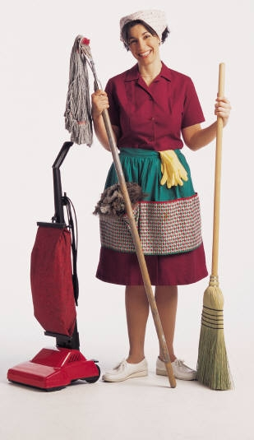
Room attendant & organisation
The role of room attendants is quite extensive, however where does this position fit into the larger picture of a hospitality or tourism organisation?
Notes:
Class Activity – General Discussion
Where does a room attendant work in a hotel?
Who is their manager?
Who are their colleagues?
Are they managers of anyone?

Slide 24
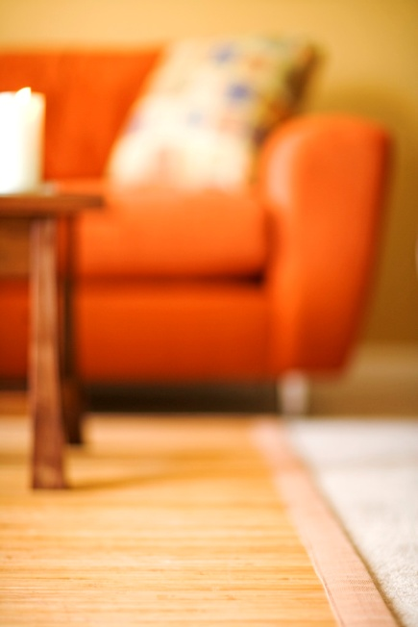
Their immediate department
Room attendants work in the Housekeeping department.
Housekeeping is responsible for:
The cleanliness of the hotel
Lost property
Laundry and dry cleaning.
Notes:
Class Activity – General Discussion
What are all the activities housekeeping perform under these three categories?

Slide 25
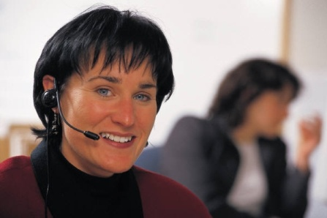
Their wider department
Housekeeping department is part of Rooms Division.
This department is responsible for all activities relating to accommodation including:
Reservations
Switchboard
Reception
Concierge.
Notes:
Class Activity – General Discussion
What are all the activities perform under these categories?

Slide 26

Their supervisor
The persons whom a room attendant will normally report to the following:
Senior Room Attendant
Housekeeping supervisor
Executive Housekeeper
Rooms Division Manager.
Notes:
Class Activity – General Discussion
What do each of these people do?
A senior room attendant or Housekeeping supervisor - This person is normally responsible for the allocation of rooms and to check rooms up on completion of cleaning by room attendants.
The head of Housekeeping is called the Executive Housekeeper – responsible for Housekeeping department. This person will report to the Rooms Division Manager – responsible for Front Office and Housekeeping departments.

Slide 27
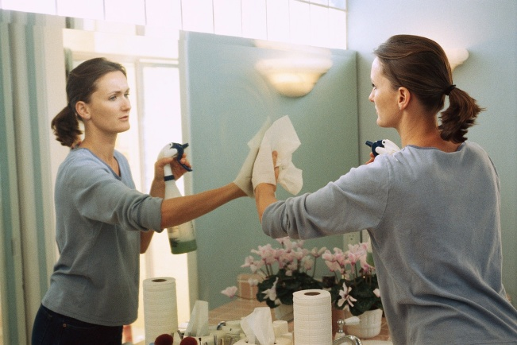
Characteristics of a room attendant
Whilst some of the personal characteristics of a room attendant is similar to those of anyone else working in the tourism and hospitality industry, there are also job specific skill sets that are required.
What characteristics are important for a room attendant to have?
Notes:
Class Activity – General Discussion
What characteristics are important for a room attendant to have?

Slide 28
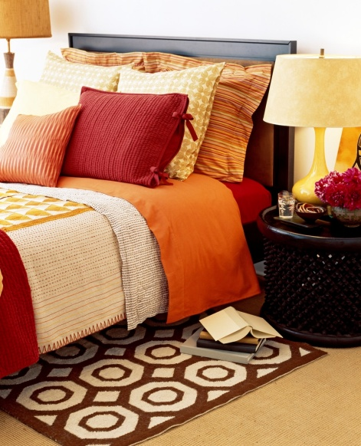
Characteristics of a room attendant
Knowledge
Working condition of all items
Hotel and room facilities
Knowledge of cleaning equipment and chemicals
Procedures for cleaning a room
Safety and security.
Notes:
Class Activity – General Discussion
What information do they need to know about the hotel?
What information do they need to know about the hotel?
What cleaning products do they use?

Slide 29
Characteristics of a room attendant
Skills
Ability to perform cleaning duties in a thorough and efficient manner
Manual handling.
Notes:
Class Activity – General Discussion
What is manual handling?

Slide 30
Characteristics of a room attendant
Attributes
Hard working
Physical strength
Ability to follow instruction
Good time management
Attention to detail.
Notes:
Class Activity – General Discussion
Hard working
Physical strength - mobility and stamina required to clean for large periods of time
Ability to follow instruction – most activities follow strict procedures
Good time management – most room attendants will need to clean approximately 12-20 rooms per shift, with no supervision
Attention to detail – ability to ensure cleaning is performed to an extremely high standard.

Slide 31

Characteristics of a room attendant
Attributes
Professional attitude
Ability to work independently
Previous customer service experience
Good communication skills
Good organisational skills.
Notes:
Class Activity – General Discussion
Why is organisational skills important?
The trainer may want to mention organisational skills are vital because room attendants work by themselves, in remote locations and under strict timeframes.

Slide 32
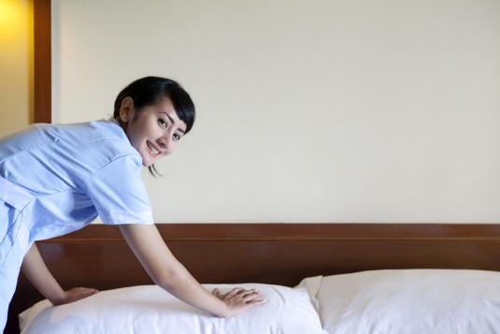
Characteristics of a room attendant
Attributes
Integrity and confidentiality – room attendants need to respect guests’ privacy
Honesty – room attendants have no right to take guest belongings or even items like perfume, food or drink
Discretion – guest information or activities are not allowed to be shared with others.
Notes:
Class Activity – General Discussion
Discuss in pairs:
What are some of the ‘temptations’ a room attendant needs to resist when he/she has access to a guest’s room?
Should a room attendant share information with others about a guest if he/she thinks what the guest is doing is morally wrong?
In what instances can a room attendant report to management on a guest’s activities in their room?

Slide 33

Grooming & personal presentation
In all aspects of grooming, room attendants should reflect expectations of the guest and the property.
Most organisations will have strict grooming standards to:
Ensure consistency
Build confidence and pride of staff
Uphold a professional image.
Notes:
Class Activity – General Discussion
Why are having grooming standards important?
What are common grooming standards?
Why is it harder to maintain grooming standards as a room attendant compared with other jobs?
How can you combat this?

Slide 34
Grooming & personal presentation
What are expected standards for:
Clothing
Name Badge
Hair
Nails
Jewelry
Make Up.
Notes:
Clothing
All clothes should be:
Clean at the start of each day
Replaced if soiled to a unsuitable standard
Worn in its correct manner
Shoes to be suitable for the role.
Name Badge
A staff member must wear their name badge at all times
This is normally in a particular position on each staff member.
Hair
Short and neat cut hair for men
Tight or pulled back hair for women
Natural hair color
Men to have well trimmed facial hair or to be clean shaved.
Nails
Short and well trimmed
No bright nail polish
Cleaned on a regular basis.
Jewellery
One dress ring or wedding ring
Suitable watches
No other jewelry including bracelets, earrings, nose rings or necklaces.
Make up
No excessive make up
No visible tattoos.

Slide 35
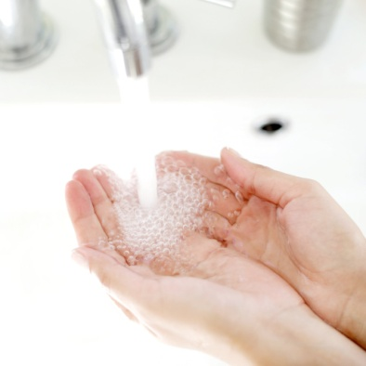
Grooming & personal presentation
What are expected standards for:
Odour
Personal hygiene
Personal belongings.
Notes:
Odour
No excessive perfumes
Staff should use deodorant on a regular basis. This is important in a labour intensive role like cleaning rooms.
Personal hygiene
Bath or shower before work
Teeth must be brushed
Hands and face must be washed and cleaned.
Personal belongings
No personal bags in work areas – to reduce chance of theft
No mobile phones.

Slide 36

Policies and procedures
Each organisation will have its own policies and procedures.
Their main provision is to ensure the health, safety, security and privacy of the organisation, staff and customers.
Policy – rule or code of conduct
Procedure – step by step instruction.
Notes:
Class Activity – General Discussion
What are common policies and procedures in any work place regardless of position?
What are common policies and procedures specific to room attendants?

Slide 37
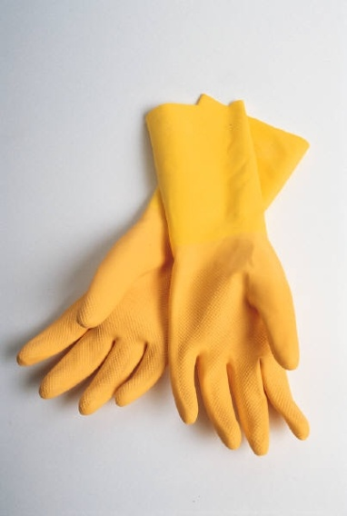
Policies and procedures
Examples of housekeeping policies
No stealing
Guest room doors cannot be closed whilst cleaning
Protective clothes to be worn when cleaning
Confidentiality of guest information.
What other policies exist?
Notes:
Class Activity – General Discussion
Get the trainees to think of other policies that are directly related to room attendants.

Slide 38
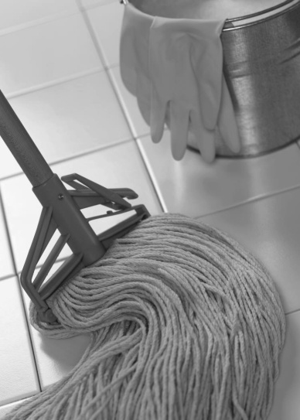
Policies and procedures
Examples of housekeeping procedures
Accessing a room
Making a bed
Cleaning a window
Cleaning a bathroom
Mopping a floor
Handling lost property.
What other procedures exist?
Notes:
Class Activity – General Discussion
Get the trainees to think of other procedures that are directly related to room attendants.

Slide 39
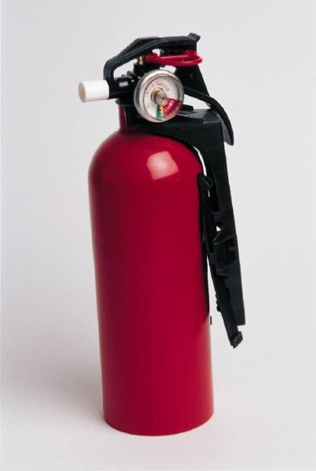
Policies and procedures
Who creates policies and procedures
Policies and procedures may be created by:
Individual housekeeping department – for specific use in that location
Head office – for use throughout the chain
Manufacturers – to identify the correct methods for use and maintenance.
Notes:
Class Activity – General Discussion
Get the trainees to identify different policies and procedures that would come from each area identified in the slide.

Slide 40
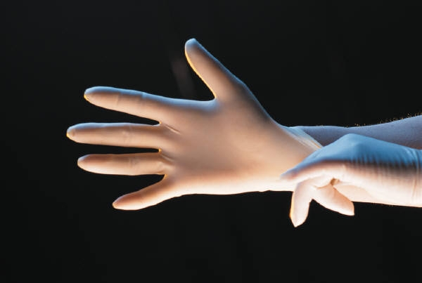
Policies and procedures
Types of policies and procedures
Policies and procedures in housekeeping normally relate to the correct handling, use, cleaning, storage and protective items relating to:
Equipment
Chemicals
Furnishings
Fittings
Clothing.
Notes:
Types of policies and procedures
Policies and procedures in housekeeping normally relate to the correct handling, use, cleaning, storage and protective items relating to:
Equipment – housekeeping cleaning equipment including vacuum cleaners, waxing machines, trolleys
Chemicals – including all cleaning products and items used to clean including cloths, rags, mops
Furnishings – bedding, tables, couches, kitchens, televisions, carpets
Fittings – lights, electricals, air conditioners
Clothing – uniforms and protective clothing.

Slide 41

Policies and procedures
Finding out about policies and procedures
Job Descriptions
Training sessions
Standard Operating Procedures
Checklists and Task Sheets
Observation by colleagues
Supervision and instruction by management.
Notes:
Class Activity – General Discussion
In your point of view, what is the best way to ensure staff know and understand policies and procedures?

Slide 42

Communication
As most staff will never enter a guest room except for a room attendant, it is important that room attendants are the eyes and ears for the hotel, either to update the status of rooms or co-ordinate any appropriate services to be performed, including maintenance, in a timely manner.
Notes:
Class Activity – General Discussion
What types of information are communicated by room attendants?
Who do they communicate with?

Slide 43
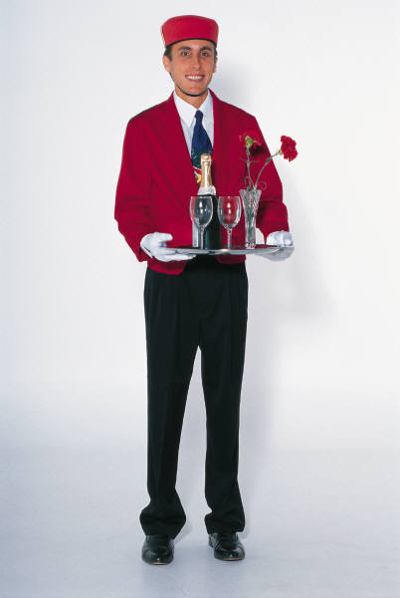
Communication
Room attendants usually communicate with:
Receptionists
House Attendants
Maintenance
Mini Bar
Room Service
Security.
Notes:
Class Activity – General Discussion
For each of these positions what information is communicated?
Receptionists
Room attendants work closely with reception for a number of reasons including:
Identify vacant rooms - to find out when guests have checked out so they can start cleaning vacant dirty rooms
Report clean rooms - when rooms are clean and ready for new guests
Handle special requirements - for incoming guests including VIP’s
Handle guest requests - relating to the room including additional towels and pillows, buckets of ice and for laundry to collected
Co-ordinate internet access.
House Attendants
These people will normally be responsible for the distribution of items to/from the housekeeping office to the store rooms on each floor, for easier access by room attendants.
These items include:
Cleaning products - sprays, agents and cleaning clothes
Equipment – buckets and mops
Linen – bed sheets, pillow cases, blankets, bath towels, floor mats, hand towels and face cloths
Room supplies – including shampoo, conditioners, stationery, matches, soaps etc
Fresh produce – milk and biscuits for tea and coffee facilities
Removal of dirty items – soiled bedding and rubbish
Collection of return of laundry or dry cleaning
As a room attendant will normally be stationed on a selected floor, they will communicate with house attendants if items need to replenished.
Maintenance
Room attendants will often call maintenance to fix or replace light bulbs and any faulty furnishings or equipment. In most cases any calls will be made relating to faulty televisions and air conditions.
Mini Bar
In some organisations, the room attendant may be responsible for replenishing mini bar items and charging them to the guest rooms themselves or may contact mini bar for this service to be performed.
Room Service
When cleaning rooms, room attendants will remove used room service trays which must be placed out of guest sight and placed in the appropriate storage area on each guest floor. They will communicate with room service for the trays to be collected from the storage areas.
Security
With room attendants spending the majority of their shift working on guest floors, it is their responsibility to observe activities that take place around them. They must constantly listen and watch to ensure guest activities are conducted in a safe and secure manner. If there are any issues which they cannot resolve, security must be contacted quickly.

Slide 44

Element 2:
Prepare for cleaning duties
Notes:
Introduce topic.
Class Activity – General Discussion
Ask general questions:
What cleaning duties are performed?
What preparation do they need to do before they can start cleaning?

Slide 45
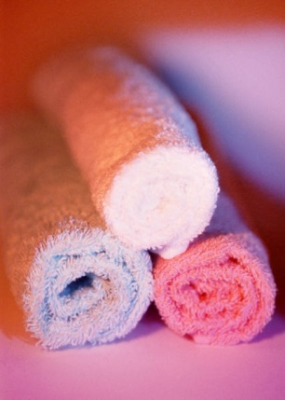
Preparing for cleaning duties
Performance Criteria for this Element are:
Replenish linen room supplies
Load housekeeping trolley with supplies for service
Check housekeeping trolley prior to use
Identify rooms to be cleaned for the shift
Access and enter guest room appropriately.
Notes:
Trainer identifies the Performance Criteria for this Element, as listed on the slide.

Slide 46
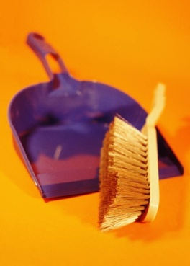
Replenish supplies
Before guest rooms are serviced, there is a need to prepare the linen room supplies and trolley that will be used to cart the cleaning materials and the room supplies to those rooms.
Notes:
Class Activity – General Discussion
What items need to be replenished?
For each item: Where do they go – in a linen store or straight on a trolley?

Slide 47

Equipment supplies
Housekeeping trolley
Vacuum cleaner
Mops
Brooms and brushes
Buckets.
Notes:
Class Activity – General Discussion
What is the purpose of each piece of equipment identified in this slide?
When preparing the equipment what would you need to do?

Slide 48
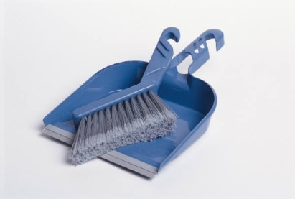
Equipment supplies
Protective gloves
Housekeeping uniform
Cloths
Warning signs
Dust pan.
Notes:
Class Activity – General Discussion
What is the purpose of each piece of equipment identified in this slide?
When preparing the equipment what would you need to do?

Slide 49
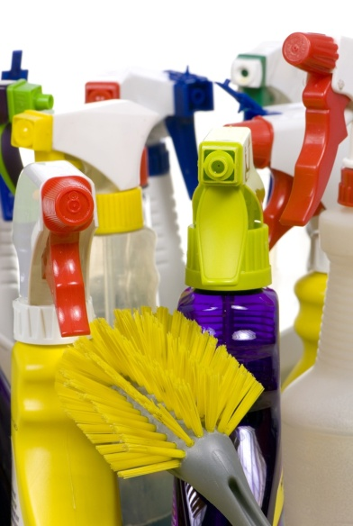
Cleaning and chemical supplies
Polishes
Detergents
Glass cleaner
Multi-purpose cleaners
Oven cleaners
Stainless steel cleaners
Leather cleaners.
Notes:
Class Activity – General Discussion
What is the purpose of each of the cleaning supplies identified in this slide?

Slide 50
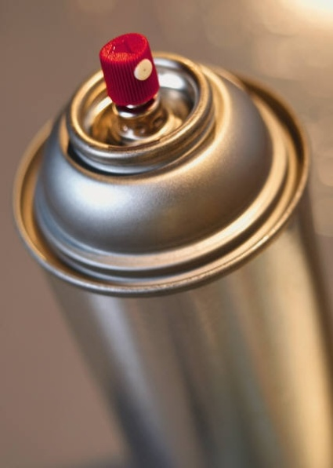
Cleaning and chemical supplies
Porcelain and ceramic cleaners
Toilet and urinal cleaners
Dishwashing detergent
Sanitisers
Disinfectants
Deodorisers and air sprays
Pest control sprays and similar.
Notes:
Class Activity – General Discussion
What is the purpose of each of the cleaning supplies identified in this slide?

Slide 51

Other supplies
Bed linen
Towels
Toiletries
Stationery
Paper products
Promotional and Informational Material
Bags
Give away items
Replacement items.
Notes:
Class Activity – Group work
The trainer arrange the trainees into small groups.
Allocate one of the topics in this slide to each group.
Get them to identify all the supplies that would be allocated to each section.
Get the trainees to discuss or list on board.

Slide 52
Ordering and receiving supplies
When requesting supplies you may be required to complete a requisition form.
The requisition form is an internal stock ordering form that you fill in and give to the Head Housekeeper identifying:
Person requesting the items
Type of items needed
Quantity
Date.
Notes:
Class Activity – Review documents
The trainer should get a copy of a ordering or requisitioning document and explain it to the class.

Slide 53

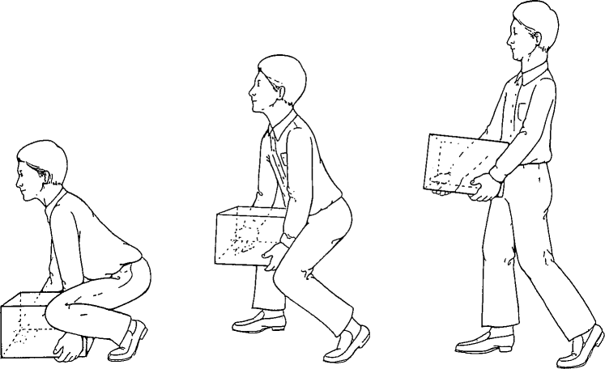
Loading housekeeping trolley
Health and safety issues need to be addressed when loading housekeeping trolleys
Manual handling activities are the main cause of injuries in the workplace and the housekeeping department traditionally gives rise to the majority of OHS injuries.
Notes:
Class Activity – General Discussion
What is manual handling?
Why is it important not just in loading trolleys, but when completing all tasks as a room attendant?

Slide 54
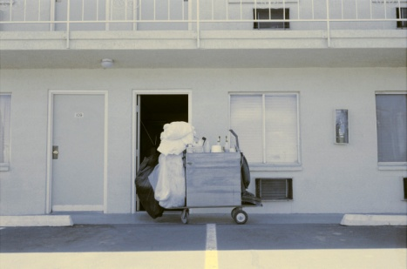
Loading housekeeping trolley
Manual Handling
Manual handling activities include:
Lifting – of stock, cartons and boxes
Carrying – items from storage areas to trolleys, moving stock from place-to-place
Pulling – boxes and cartons forward in storage areas
Pushing trolleys.
Notes:
Class Activity – General Discussion
What items do room attendants normally:
Lift
Carry
Pull
Push.
The trainer should demonstrate the best way to do these movements.
Also get the audience to think of strategies to prevent injury (use of specific equipment etc) when using these range of movements.

Slide 55

Loading housekeeping trolley
Key points to remember when stocking or handling trolleys:
Report any damage or faults with the trolley.
Push the trolley, don’t pull it
Always stock items in their designated place on the trolley
Never lift anything on your own that weighs over 16 kg
Be prepared to ask for help when needed.
Notes:
Class Activity – General Discussion
Discuss the points in the slide and why they are important.

Slide 56
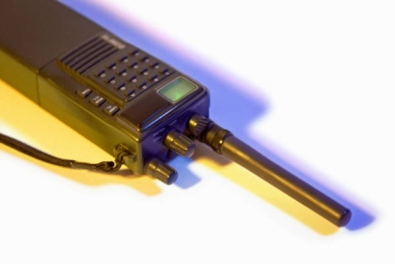
Check housekeeping trolley
Before leaving the housekeeping office or linen store it is vital that you have all the necessary supplies on your housekeeping trolley.
Additional items include:
Keys for floors and rooms
Communication walkie-talkie
List of rooms to clean and alternate rooms
Personal drink container.
Notes:
Class Activity – General Discussion
Discuss the points in the slide and why they are important
These are not considered as supplies, but are vital.

Slide 57

Security of housekeeping trolley
It is important to maintain security of trolleys in hallways as:
They contain many valuable items
Staff work out of sight of trolleys
Contains information of guests.
Lock trolleys where possible.
Notes:
Class Activity – General Discussion
Why is it easy for guests to steal from trolleys? If you were a guest how could you do it?
What would you steal?
How can staff prevent this?

Slide 58
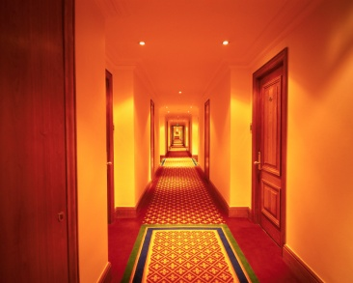
Position of housekeeping trolley
Always position the trolley near the wall and out of the guest’s way.
Don’t leave them in the middle of the corridor as:
It makes it harder for movement of people in the corridor
It makes it more appealing for theft
It helps avoid injuries
Ensures a clear path in the event of an emergency.
Notes:
Class Activity – General Discussion
Most organisations require trolleys to be placed in front of the open door to the room they are cleaning
What are the reasons for this?

Slide 59
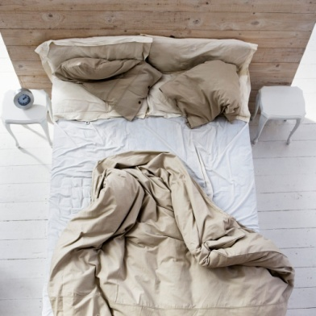
Identify rooms to be cleaned
In order to service rooms in a timely fashion and to control labour costs, every property will allocate specific rooms to individual staff for room preparation duties.
The primary role of a room attendant is to clean rooms.
Notes:
Class Activity – General Discussion
What needs to be considered when identifying rooms to be cleaned, and in what order?

Slide 60
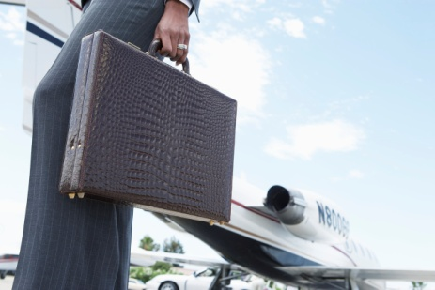
Identify rooms to be cleaned
Housekeeping briefing session
Verify staff working
Discuss up-coming information
Discuss VIP’s requirements
Address room servicing problems
Address complaints received by guests
Identify up-coming training sessions
Allocate rooms to individual staff for the shift.
Notes:
Class Activity – General Discussion
When do briefings normally take place?
Who normally directs these sessions?
How long do they usually take?

Slide 61
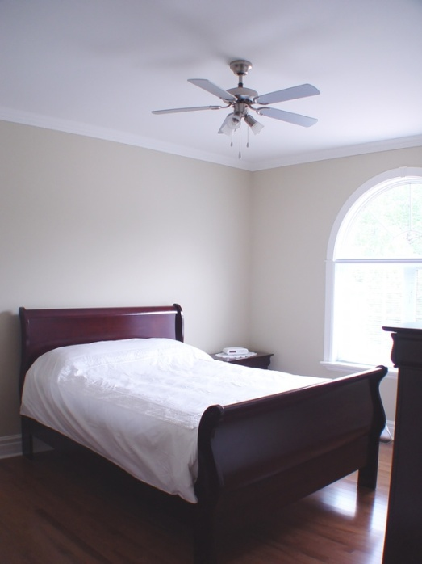
Identify rooms to be cleaned
Most room attendants are required to clean approximately 12-20 rooms a day depending on:
Organisation standards
Types of rooms
Status of the room
Other considerations.
Notes:
Class Activity – General Discussion
What influences do each of the points in this slide have?

Slide 62
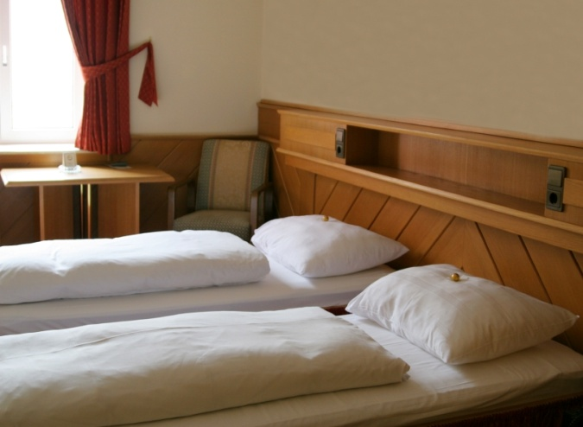
Identify rooms to be cleaned
Types of rooms
Generally it is ‘guest rooms’ that will need to be prepared.
These rooms can include:
Single rooms
Doubles
Twins
Suites.
Notes:
Class Activity – General Discussion
What is the difference between each type of room?
Who are these rooms normally allocated to?
As a cleaner, which rooms take longer to clean and why?

Slide 63
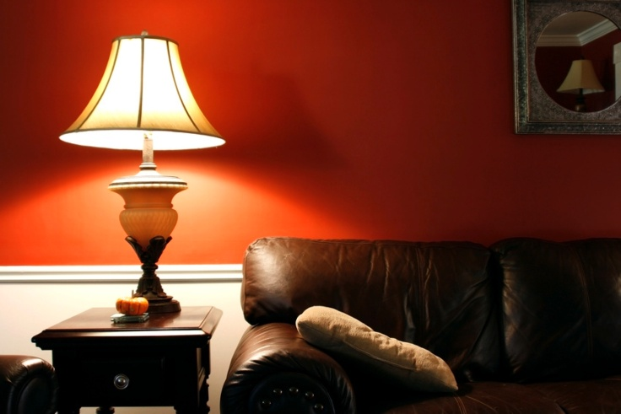
Identify rooms to be cleaned
Room inclusions
These rooms can contain their own spaces that require servicing such as:
Bathroom
Bedroom
Lounge or living area
Kitchen or kitchenette
Balcony area
Lobby or vestibule.
Notes:
Class Activity – General Discussion
Which inclusions are found in a ‘normal’ room?
As an exercise get the trainees to identify an approximate time it would take to clean each point identified in this slide providing explanation for the timing.

Slide 64

Identify rooms to be cleaned
Status of rooms
There are usually three types of rooms that need to be cleaned:
Check out rooms
Occupied rooms
Vacant rooms.
What is the difference between these rooms?
What activities are performed for each?
Notes:
Check out rooms
These are the rooms where guests are expected to check-out. They may be known as ‘departing rooms’, ‘going rooms’ or ‘vacated rooms’
These rooms will take longer to clean than a room that continues to be occupied because a full service is required. Approximately thirty minutes is allocated.
Occupied rooms
These are rooms where the guest will be staying for another night. They may also be known as ‘stay rooms’
Generally these rooms won’t take as long to clean as a check-out room, and approximately twenty minutes will be allocated.
Vacant rooms
You will also be required to inspect and provide basic service to vacant rooms.
These rooms, even though not being used, still require some attention such as:
Inspection – to identify anything that might have happened or gone wrong with or in the room
General dusting
Flushing of the toilet
Checking that the refrigerator is working properly
Ensuring the room has not been occupied by a guest for whom no information exists.

Slide 65

Identify rooms to be cleaned
Other considerations
Which rooms need to be cleaned first
Special cleaning tasks or stain removal tasks for certain rooms
Time constraints
Other areas in the venue that need to be cleaned.
Notes:
Class Activity – General Discussion
Which rooms normally need to be cleaned first?
What time constraints exist?
What other areas do room attendants have to clean?
Is this part of their normal job?
If not, who does it and why would room attendants be required to help?

Slide 66
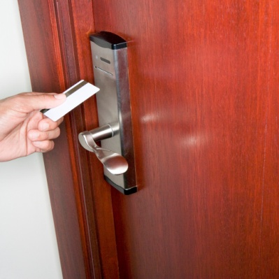
Access and enter guest room
All guest rooms must only be accessed after following the house procedures that apply.
These procedures relate to service delivery and security.
They also function to help avoid embarrassment to both guests and staff.
Notes:
Class Activity – General Discussion
What is the normal procedure for accessing and entering a room?
Why is it done this way?

Slide 67
Access and enter guest room
Standard procedure to access rooms
Knock on door (quite loudly) – use knuckles not keys or any other item as it could mark the door and call out, “Housekeeping!”
Count to five
If no answer, knock again, and then use your key to enter
Take one step into the room and announce out “Good morning/afternoon, Housekeeping to service your room.”
If the guest is still in bed, undressed or distressed, quickly and quietly leave the room.
Notes:
Class Activity – General Discussion and Role Play
Trainer to explain why steps are done as identified in the slide.
Trainees to role play accessing and entering a room.

Slide 68
Access and enter guest room
Standard procedure to access rooms
If the guest is awake and up, say “Housekeeping, would you like your room serviced?”
Comply with their request – you may be invited to service the room, just do a quick tidy, replace the towels, soap and leave, or asked to come back at a later time
Once you have gained access to the room, the door should be left wide open – to provide notice to a returning guest that someone is in their room.
Notes:
Class Activity – General Discussion and Role Play
Trainer to explain why steps are done as identified in the slide.
Trainees to role play accessing and entering a room.

Slide 69
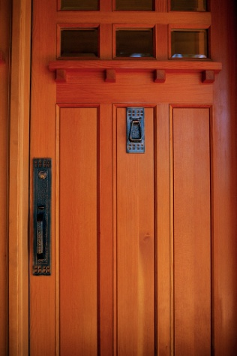
Access and enter guest room
Standard procedure to access rooms
The trolley should be parked across the entrance, or near the entrance to the room
It is standard procedure in the majority of establishments for trolleys to be left outside the room being cleaned
Where the trolley is allowed to be taken into the room, a large sign should be placed reading ‘Cleaning in Progress’.
Notes:
Class Activity – General Discussion and Role Play
Trainer to explain why steps are done as identified in the slide.
Trainees to role play accessing and entering a room.

Slide 70

Element 3: Make beds
Notes:
Introduce topic.
Class Activity – General Discussion
Ask general questions:
What activities occur when making a bed?
Does this differ for a new guest compared with an existing guest?

Slide 71

Make beds
Performance Criteria for this Element are:
Strip and re-make bed with fresh bed linen
Re-make bed using existing bed linen.
Notes:
Trainer identifies the Performance Criteria for this Element, as listed on the slide.

Slide 72

Strip and make a bed
Once you have successfully entered the room, it is now time to start cleaning the room
One of the first tasks is normally to make the beds
Beds will need to be stripped in all departing rooms and at nominated intervals for staying guests.
Notes:
Class Activity – General Discussion
What does stripping a bed involve?
Where should you place the items you have stripped?

Slide 73
Strip and make a bed
When should the bed be stripped?
Options include:
Daily – in high-priced rooms, prestige establishments: full change
Every second or third day – full change
Change when the condition of the linen requires it – such as situations where linen is dirty or damaged.
Notes:
Class Activity – General Discussion
What do you think is a suitable time frame?

Slide 74
Strip and make a bed
Steps to strip a bed:
1. Remove bedspread or duvet. – inspect and air, or replace as required. All bedspreads etc are washed or dry-cleaned periodically
2. Remove blankets (where provided) - inspect and air, or replace as required. All blankets are washed or dry-cleaned periodically
3. Remove pillowcases – place into soiled linen bag. Inspect pillow and pillow protectors to determine if they require attention or replacement
(Continued)
Notes:
Class Activity – General Discussion and Demonstration
Trainer to demonstrate and explain why steps are done as identified in the slide.
Trainees to practice stripping a bed.

Slide 75

Strip and make a bed
Steps to strip a bed:
4. Remove sheets - place into soiled linen bag
5. Check mattress protector – spot clean as necessary or replace if required due to staining or damage
6. Inspect electric blanket – safety check and for signs of staining. Replace as per house protocols
Notes:
Class Activity – General Discussion and Demonstration
Trainer to demonstrate and explain why steps are done as identified in the slide.
Trainees to practice stripping a bed.

Slide 76

Strip and make a bed
Damaged or soiled bed items
When damaged items are found they must be replaced or forwarded for repair or disposal.
Types of stains:
Urine and faeces
Blood
Beverage – tea, soft drinks, alcohol
Shoe polish
Food
Mud, dirt, grease and oil.
Notes:
Class Activity – General Discussion
What are common stains on bed items?

Slide 77

Strip and make a bed
Remaking bed with fresh linen
Making the bed ‘properly’ is an extremely important part of servicing any room because the bed is often the focal point of the room and one of the first things in the room that the guest looks at
The final appearance of the made bed must therefore make the right impression – neat, tidy, balanced, crisp, clean, attractive and inviting.
Notes:
Class Activity – General Discussion
What is involved in making a bed?

Slide 78

Strip and make a bed
Bed making styles
The standard style to make a bed involves:
Mattress protector
Bottom sheet
Top sheet
Blanket
Bedspread
Pillows
Pillowcases.
Other styles include ‘American’ and ‘Norwegian’.
Notes:
Class Activity – General Discussion
What is the purpose of each bedding item?
Trainer to explain how the ‘American’ and ‘Norwegian’ (refer to notes) styles differ and why they are used.

Slide 79

Strip and make a bed
Bed making steps
1. Check electric blanket is straight and secured
2. Position mattress protector and secure strings
3. With seams down, position bottom sheet
4. Mitre bottom sheet
5. Smooth out creases
6. With seams up, position top sheet
(Continued)
Notes:
Class Activity – General Discussion and Demonstration
Trainer to demonstrate and explain why steps are done as identified in the slide.
Trainees to practice making a bed.

Slide 80

Strip and make a bed
Bed making steps
7. Position blanket – seams up
8. Turn head of top sheet over blanket
9. Smooth out creases
10. Tuck in top sheet and blanket on sides
11. Mitre all corners, top sheet and blanket together
12. Smooth out creases
(Continued)
Notes:
Class Activity – General Discussion and Demonstration
Trainer to demonstrate and explain why steps are done as identified in the slide.
Trainees to practice making a bed.

Slide 81

Strip and make a bed
Bed making steps
13. Position bedspread so it is straight and all corners are even.
14. Fold back bedspread at bedhead end.
15. Place pillowcases on fluffed up pillows.
16. Position pillows on the bed as required.
17. Fold bedspread over pillow and neatly tuck in.
Notes:
Class Activity – General Discussion and Demonstration
Trainer to demonstrate and explain why steps are done as identified in the slide.
Trainees to practice making a bed.

Slide 82
Strip and make a bed
What do you do differently when making a bed using existing linen instead of fresh linen?
Remember guest preferences:
If they have removed the blanket or duvet, you may wish to place this in the cupboard or folded back at the end of the bed
If they have more pillows, make the bed and position the pillows accordingly
If items such as books, magazines, glasses, clothes or other personal items were found on the bed, place them back on the bed in a similar position and in a neat state.
Notes:
Remaking a bed using existing bed linen
Whilst the instructions may reflect those previously given in Section 3.1, it is important that clear procedures are identified when making a bed for an occupied room.
1. Remove pillows and place them on a clean surface, checking for stains or need for replacement
2. Remove or pull back any blankets or duvets, again checking for stains or need for replacement
3. Straighten bottom sheet, again checking for stains or need for replacement. If a new sheet is required, change accordingly.
4. Re-tuck in sheet
5. Smooth out creases
6. With seams up, position top sheet – top edge even with mattress at bed head
7. Position blanket – seams up
8. Turn head of top sheet over blanket
9. Smooth out creases
10. Tuck in top sheet and blanket on sides
11. Mitre all corners, top sheet and blanket together
12. Smooth out creases
13. Position bedspread so it is straight and all corners are even
14. Fold back bedspread at bedhead end
15. Place pillowcases on fluffed up pillows
16. Position pillows on the bed as required
17. Fold bedspread over pillow and neatly tuck in.

Slide 83

Element 4:
Clean bathroom
Notes:
Introduce topic.
Class Activity – General Discussion
Ask general questions:
What activities occur when cleaning a bathroom?
How long should it take to clean a bathroom?

Slide 84

Clean bathroom
Performance Criteria for this Element are:
Clean bath and shower area
Clean toilets
Clean vanity area
Clean floors
Replenish guest supplies.
Notes:
Trainer identifies the Performance Criteria for this Element, as listed on the slide.

Slide 85

Preparing a bathroom for cleaning
Collect all dirty toweling items and place in soiled laundry bag
Collect all used bathroom supplies
Check shower curtain for cleanliness
Check all light globes
Check all electrical equipment
Check all fixtures and fittings.
Notes:
Class Activity – General Discussion
Discuss the points explaining why they are important to undertake.

Slide 86

Preparing a bathroom for cleaning
Handling syringes
1. Don’t panic
2. Don’t touch the needle with bare hands and do not attempt to recap it
3. Find a sturdy plastic container
4. Ease the syringe into the container without making skin contact with it – where applicable, use a brush and shovel to sweep syringe up
5. Tightly seal the container
6. Immediately wash your hands
7. Immediately alert the appropriate person for correct disposal of syringe.
Notes:
Class Activity – General Discussion
Why is it so important to handle syringes in the right manner?
Why are syringes commonly found in rooms?

Slide 87
Cleaning the bath
1. Wet tub with water and check plughole for foreign matter
2. Scour tub using non-metal pad – removing stains, residue and marks
3. Clean and polish taps
4. Rinse bath thoroughly
5. Dry and polish with cloth
6. Conduct final inspection.
Notes:
Class Activity – General Discussion and Demonstration
Trainer to demonstrate and explain why steps are done as identified in the slide.
Trainees to practice cleaning a bath.

Slide 88

Cleaning the shower
1. Wet shower basin and sides
2. Clean tiles and floor – check plughole for foreign matter
3. Clean shower curtain – check pole is clean and all hooks are in place and working
4. Rinse walls and floor thoroughly
5. Polish fittings
6. Replenish supplies
7. Conduct final inspection – leave shower curtain neat and to one side.
Notes:
Class Activity – General Discussion and Demonstration
Trainer to demonstrate and explain why steps are done as identified in the slide.
Trainees to practice cleaning a shower.

Slide 89

Cleaning the toilet
1. Flush toilet to wet sides of bowl
2. Pour in cleanser – leave to soak: continue with other work
3. Wash lid and dry – both sides and near back hinges
4. Wash seat and dry – both sides and near back hinges
5. Wash outsides of the bowl and dry
(Continued)
Notes:
Class Activity – General Discussion and Demonstration
Trainer to demonstrate and explain why steps are done as identified in the slide.
Trainees to practice cleaning a toilet.

Slide 90

Cleaning the toilet
6. Wash and dry water holding unit and polish button
7. Scour bowl thoroughly – use a toilet brush
8. Flush toilet a number of times to wash away dirt and residue
9. Place a hygiene strip over the closed toilet lid
10. Conduct final inspection – leave lid down when thoroughly cleaned. Add hygiene strip, if appropriate.
Notes:
Class Activity – General Discussion and Demonstration
Trainer to demonstrate and explain why steps are done as identified in the slide.
Trainees to practice cleaning a toilet.

Slide 91

Cleaning the vanity area
The vanity area normally includes:
Bathroom bench
Basins
Taps
Mirror
Cupboards
Handtowels
Amenities
Soap containers.
Notes:
Class Activity – General Discussion
Types of towels are used in a bathroom?
What amenities are normally supplied in the vanity area?
What are appropriate amenities for men?
What are appropriate amenities for women?

Slide 92

Cleaning the vanity area
1. Clean and dry shelves – replacing guest’s toiletries, where applicable
2. Scrub hand basin, rinse, then dry and polish with clean cloth – check plughole
3. Polish fittings and taps
4. Clean and dry wall tiles
5. Clean, dry and polish bench top
(Continued)
Notes:
Class Activity – General Discussion and Demonstration
Trainer to demonstrate and explain why steps are done as identified in the slide.
Trainees to practice cleaning a vanity area.

Slide 93

Cleaning the vanity area
6. Clean and polish mirror
7. Check under vanity for cleanliness – cobwebs, etc
8. Replenish stock – soap, tissues, facial items, shower caps, water
9. Replenish towels – bath, face, hand, and floor mats
10. Conduct final check.
Notes:
Class Activity – General Discussion and Demonstration
Trainer to demonstrate and explain why steps are done as identified in the slide.
Trainees to practice cleaning a vanity area.

Slide 94
Cleaning the bathroom floor
1. Remove everything that may be on the bathroom floor such as mats, trash cans, and small pieces of furniture
2. Sweep the floor to remove dirt, hair, dust, and other debris
3. Dissolve detergent into warm water using the manufacturer's instructions for the correct water to detergent ratio
4. Pour the solution over the entire floor so that the solution can fill into the grout lines
5. Allow the solution to remain on the floor for 15 to 20 minutes
6. Scrub the grout with a small medium-bristled brush
Notes:
Class Activity – General Discussion and Demonstration
Trainer to demonstrate and explain why steps are done as identified in the slide.
Trainees to practice cleaning the bathroom floor.

Slide 95

Cleaning the bathroom floor
7. Rinse the floor with a mop dampened with clean water
8. Mix a second batch of detergent and water
9. Mop the entire floor with the fresh solution
10. Rinse the mop with clean water and mop a second time over the floor to rinse it
11. Use a squeegee to push residual moisture to one area of the floor before absorbing it with dry towels.
Notes:
Class Activity – General Discussion and Demonstration
Trainer to demonstrate and explain why steps are done as identified in the slide.
Trainees to practice cleaning the bathroom floor.

Slide 96

Replenishing guest supplies
Bathroom guest supplies:
Toilet paper and sanitary pads and bags
Tissues
Towels including hand towels, face cloths, bathmats, bath towels
Shampoo
Conditioner
Moisturiser.
Notes:
Discuss why each of these amenities are included.

Slide 97

Replenishing guest supplies
Bathroom guest supplies:
Hand lotion
Toothbrushes and toothpaste
Make up remover
Combs
Water
Soap
Perfumes, aftershaves and other fragrances
Sewing kits.
Notes:
Discuss why each of these amenities are included.
Are there any additional amenities that would be beneficial for guests?

Slide 98

Final check of bathroom
Before leaving the bathroom, do a final check noting the following points:
Bathroom looks clean and tidy
Towels and guest supplies have been replenished and stocked accordingly
Toilet paper is well stocked
All appliances are working
All surfaces are clean and dry.
Notes:
Discuss why it is important to ensure the bathroom is completely clean before moving onto other tasks.

Slide 99
Element 5: Clean room
Notes:
Introduce topic.
Class Activity – General Discussion
Ask general questions:
What activities occur when cleaning a room?
How long should it take to clean a room?

Slide 100

Clean room
Performance Criteria for this Element are:
Follow in-house requirements and policies in relation to room cleaning
Clean fixtures and fittings
Vacuum floors and other areas
Clean kitchenette area, where applicable.
Notes:
Trainer identifies the Performance Criteria for this Element, as listed on the slide.

Slide 101

Clean room
Performance Criteria for this Element are:
Replenish guest supplies
Check operational readiness of all items and equipment
Report and remedy room defects and damaged items
Report suspicious items or situations
Handle guest property left in room from which guest departed.
Notes:
Trainer identifies the Performance Criteria for this Element, as listed on the slide.

Slide 102
Protocol for cleaning a room
Where your premises vary from these, adhere to house policy:
1. Enter and prepare room
2. Strip and make bed
3. Clear and clean bathroom
4. Replenish all bathroom supplies
5. Dust and polish
6. Replenish guest supplies
7. Clean bins
8. Clean fridge
9. Vacuum
10. Deodorise
11. Do a final inspection.
Notes:
Class Activity – General Discussion
The steps to cleaning a room may have already been clarified but it is good to revise and to be able to explain to trainees what we have currently covered to date.

Slide 103
Protocol for cleaning a room
Protocols when cleaning an occupied room
Never throw out any items like magazines and newspapers belonging to the guest
If business papers are out on the desk or table and obviously being used, avoid cleaning or tidying that area
Respect the guest’s privacy and don’t be nosy
Take special care with all guest’s items
Hang guest’s clothing up appropriately
All cloths used in cleaning should be housekeeping issued – room towels and linen should never be used for cleaning.
Notes:
Class Activity – General Discussion
Discuss the reasons why certain protocols exist when cleaning an occupied room.

Slide 104

Cleaning furniture, fixtures and fittings
All rooms will have furniture, fixtures and fittings to some extent.
Furniture commonly refers to items in the room that are movable including beds, couches, desks, television, clock radios etc
Fixtures refer to items that are attached that are used by the guest including air conditioners, light controls
Fittings refers to taps, pipes and electrical aspects of the room.
Notes:
Class Activity – General Discussion
What other furniture items are there in a room?
What other fixture items are there in a room?
What other fitting items are there in a room?
How do you clean these?

Slide 105

Dusting and polishing
The main purpose of dusting and polishing is to:
Collect small particles of dust
Clean the item and leave a shiny, reflecting finish.
When polishing an item, make sure to:
Spray the cleaning agent onto the cloth - not onto the surface to be cleaned
Buff the surface after cleaning to remove any streaks
Notes:
Class Activity – General Discussion
What items do you dust and polish?
What is the difference between dusting and polishing?

Slide 106

Dusting and polishing
Items to dust and polish:
Air conditioning vents
Doors
Picture frames
Mirrors – frame and mirror
Skirting boards
Dressing table and drawers
Side tables and ledges
Wardrobe and internal shelving
Windows – glass and frames.
Notes:
Class Activity – General Discussion and Demonstration
Trainer to demonstrate and explain why steps are done as identified in the slide.
Trainees to practice polishing and dusting some items identified in the slide.

Slide 107

Dusting and polishing
Items to dust and polish:
Window sills
Walls
Lamps
Telephone
Seat furniture
All furniture
Outside/balcony areas.
Notes:
Class Activity – General Discussion and Demonstration
Trainer to demonstrate and explain why steps are done as identified in the slide.
Trainees to practice polishing and dusting some items identified in the slide.
Window sills
Walls – check for cobwebs and marks
Lamps – base, shade and cord
Telephone – main unit and hand receiver
Seat furniture – don’t forget to remove cushions and check sides, legs, back and underneath
All furniture – top, sides, legs, and underneath each item; don’t forget to clean inside the drawers
Outside/balcony areas – furniture, ash trays.

Slide 108

Cleaning bins
Waste bins should be properly cleaned by:
Tying the bin liner around the rubbish or emptying the bin directly into your waste bag on the trolley. Remove larger and non-dangerous by hand to facilitate this process where applicable
Spraying bin with appropriate multi-purpose cleaner, inside and out
Cleaning with the appropriate cloth
Fitting a new bin liner.
Notes:
Class Activity – General Discussion and Demonstration
Trainer to demonstrate and explain why steps are done as identified in the slide.
Trainees to clean a bin.

Slide 109
Vacuum floors
All carpeted areas should be vacuumed and many non-carpeted areas including wooden floors, tiled bathroom area, linoleum floors in kitchenette may also require vacuuming.
Notes:
Class Activity – General Discussion
What is the purpose of vacuuming?

Slide 110

Vacuum floors
Vacuuming tips:
Try to vacuum the room starting at the furthest corner from the door and work back toward the exit
Ensure you vacuum around and under all furniture, and under the bed
Particular attention should be placed on the corners of the room, including the skirting boards
bend your knees when cleaning under items
Try to avoid ‘bending over’ the machine.
Notes:
Class Activity – General Discussion and Demonstration
Trainer to demonstrate and explain why steps are done as identified in the slide.
Trainees to practice vacuuming.

Slide 111

Clean kitchenette
Kitchenette items
Refrigerator
Stove & Oven
Microwave
Dishwasher
Tea and coffee making facilities
Pots and Pans
Crockery and cutlery
Washer and dryer.
Notes:
Class Activity – General Discussion
What other items are often found in a kitchenette?
How long should it take to clean?
What steps are involved?

Slide 112
Cleaning the refrigerator
Clean the inside of the refrigerator, including seals, with either hot soapy water or a designated spray-on cleaner.
Dry with a cloth when the cleaning has been done
Make sure food products and glasses are protected
Replenish cold water in jugs, milk sachets and ice trays
Switch refrigerator back on if it has been turned off prior to cleaning
Check the refrigerator door seals for splits and cracks
Report items needing repair.
Notes:
Class Activity – General Discussion and Demonstration
Trainer to demonstrate and explain why steps are done as identified in the slide.
Trainees to practice cleaning a refrigerator.

Slide 113
Cleaning the stove
For a gas stove:
Remove burner caps, grates, and control knobs
Put them in your sink filled with very hot water and dish soap
As these soak, dip a scrubbing sponge into the sink water and wring
Go over the stovetop, paying extra attention to any stains around the burners
Rinse with clean water; let dry
Head to the sink and wipe down each item with your sponge
Rinse and dry the parts; reassemble the cooktop.
Notes:
Class Activity – General Discussion and Demonstration
Trainer to demonstrate and explain why steps are done as identified in the slide.
Trainees to practice cleaning a gas stove.

Slide 114
Cleaning the stove
For an electric stove:
For a coil electric stovetop, do this soaking method with the drip pans and knobs but not the burners, which shouldn't be submerged
For a smooth electric stovetop, clean the surface with a nonabrasive scrubbing pad and a liquid cooktop cleaner
Dip a sponge in hot soapy water, wring well, and wipe the controls
Rinse and let dry.
Notes:
Class Activity – General Discussion and Demonstration
Trainer to demonstrate and explain why steps are done as identified in the slide.
Trainees to practice cleaning an electric stove.

Slide 115
Cleaning the oven
Inside oven
Cooked food stuck on the bottom, sides or glass of ovens can give off odours and smoke
Try to remove large or deep stuck food items with a metal spatula and gently chip off any loose pieces
Spray a cleaning agent on all sides on the inside or an oven
Wipe away
For hard to remove stains, use baking soda with a few drops of white vinegar. Let it bubble for a minute or two, then whisk away the grime with a scrub sponge
Rinse with a clean, wet, regular sponge.
Notes:
Class Activity – General Discussion and Demonstration
Trainer to demonstrate and explain why steps are done as identified in the slide.
Trainees to practice cleaning an oven.

Slide 116

Cleaning the oven
Oven glass window
Spray the inside of the window with appropriate cleaning agent
Let it soak
After a few minutes, rub down the glass with a nonabrasive scrubbing pad
Rinse with a wet sponge, and dry with a paper towel or microfiber cloth
Give the glass on the outside of the door a quick spray and wipe as well.
Notes:
Class Activity – General Discussion and Demonstration
Trainer to demonstrate and explain why steps are done as identified in the slide.
Trainees to practice cleaning an oven glass window.

Slide 117

Cleaning the dishwasher
When cleaning dishwashers, ensure:
All items have been removed and placed away in cupboards
Water is drained
Clean around area where detergent has been used
Fill rinse aid dispenser where required.
Notes:
Class Activity – General Discussion and Demonstration
Trainer to demonstrate and explain why steps are done as identified in the slide.
Trainees to practice cleaning a dishwasher.

Slide 118

Cleaning the washing machine
When cleaning washing machines, ensure:
It is empty
If items are found, process them as lost property if the guest has departed, or neatly fold for an existing guest
Clear away any leftover clothing strands from inside the machine.
Notes:
Class Activity – General Discussion and Demonstration
Trainer to demonstrate and explain why steps are done as identified in the slide.
Trainees to practice cleaning a washing machine.

Slide 119

Cleaning the dryer
When cleaning dryers, ensure:
It is empty
If items are found, process them as lost property if the guest has departed, or neatly fold for an existing guest
Clear away lint from catchment areas.
Notes:
Class Activity – General Discussion and Demonstration
Trainer to demonstrate and explain why steps are done as identified in the slide.
Trainees to practice cleaning a dryer.

Slide 120

Cleaning other items
Once the major pieces of equipment have been cleaned there are other tasks to perform.
These may include:
Washing and drying pots, pans, crockery and cutlery
Placing clean items in cupboards
Cleaning inside cupboards and doors
Refilling ice trays
Cleaning kettles.
Notes:
Class Activity – General Discussion and Demonstration
Trainer to demonstrate and explain why steps are done as identified in the slide.
Trainees to practice cleaning other items.

Slide 121

Cleaning other items
Restocking give-ways including tea, coffee and biscuits
Changing drying towels and cleaning sponges
Replenishing detergents, washing powder and cleaning agents
Placing fresh milk in the refrigerator or other items as dictated by regulations
Cleaning the microwave
Wiping down benches and sinks
Cleaning the floor.
Notes:
Class Activity – General Discussion and Demonstration
Trainer to demonstrate and explain why steps are done as identified in the slide.
Trainees to practice cleaning other items.

Slide 122

Replenish guest supplies
Depending on the establishment, there can be a number of items that will qualify as guest supplies.
The simplest definition is ‘any small item that can be used, and in some cases taken, by a guest is a guest supply’.
Notes:
Class Activity – General Discussion
What guest supplies are there?
Which ones do we allow guests to take?
Which ones do we charge for?

Slide 123

Replenish guest supplies
Guest supplies include:
Pens
Paper
Stationery
Envelopes
Fax or e-mail forms
Promotional material
Room service menus
Sewing and shoe polishing kits
Guest dry-cleaning bag.
Notes:
Class Activity – General Discussion
Discuss the guest supplies in the slide:
Where are they located?
What is their quantity?
How should they be presented?
Do they expire? If so, how can you check they are still within the expiry date?

Slide 124

Replenish guest supplies
Guest supplies include:
Guest laundry list
Tea, coffee, milk and biscuits
Iron
Fly spray
Additional blankets and pillows
Remote control units
Hair dryer
Electric jug
Basic cups, mugs, saucers, glasses, tea-spoons, bottle opener.
Notes:
Class Activity – General Discussion
Discuss the guest supplies in the slide:
Where are they located?
What is their quantity?
How should they be presented?
Do they expire? If so, how can you check they are still within the expiry date?

Slide 125

Check operational readiness of items
In-room air conditioning set at a predetermined temperature level
Refrigerator left at a nominated setting
Television set to a prescribed volume or channel
Clock set to the correct time
Alarm clock checked to ensure the alarm is not active
Radio tuned to nominated channel and set at desired volume
Dimmers set to medium setting
Toaster set to desired setting
Pens and message pads are located conveniently.
Notes:
Class Activity – General Discussion and Demonstration
Trainer to demonstrate and explain why steps are done as identified in the slide.
Trainees to practice checking the operational readiness of items.

Slide 126

Report and remedy room defects
Regardless of how well a room is maintained, general wear and tear will happen, equipment will break down and other problems will occur
When servicing a guest room is to check the room for any defects in equipment, appliances, furniture or fittings.
What are defects, what is damage?
Defects or damage can result form normal wear-and-tear, accidental damage or deliberate and malicious action by guests.
Notes:
Class Activity – General Discussion
What is the difference between a defect and damage?
What items normally have defects?
What items normally have damage?

Slide 127
Report and remedy room defects
Examples of defects and damage:
Broken refrigerator door seals
Chipped or broken glasses
Flickering fluorescent lights
Blown light globes
Remote controls with flat, or no, batteries
Broken fixtures or fittings
Refrigerators that make ‘too much’ noise
Noisy air conditioning.
Notes:
Class Activity – General Discussion
What causes it?
What can you do about it?

Slide 128
Report and remedy room defects
Examples of defects and damage:
Dripping taps
Ripped curtains and drapes that do not properly close
Ripped, tired-looking or stained furnishings
Fuzzy television reception
Electric jugs and hair dryers that don’t work
Room cards that do not easily integrate with the power controls in-room
Irons where the temperature control settings are not working.
Notes:
Class Activity – General Discussion
What causes it?
What can you do about it?

Slide 129

Report and remedy room defects
What do you do?
The course of action chosen will depend on the seriousness of the damage and whether or not someone could be harmed because of the problem.
The two possible courses of action are:
The item must be taken out of service immediately and replaced if possible
The item is reported on a maintenance report and submitted to the appropriate person for.
‘If in doubt, have it checked out.’
Notes:
Class Activity – General Discussion
Go back the list on the last 2 pages and identify which items can be:
Replaced
Will need to be repaired in the room.

Slide 130
Report and remedy room defects
Identifying damaged items
You can become aware that an item is damaged through:
Personal observation
Look for damaged items
Listen for equipment that doesn’t sounds right
Be alert to smells that indicate problems
Advice from guests.
Notes:
Class Activity – General Discussion
Personal observation and guest comments are the two common ways.
When can you observe?
How do guests normally advise staff of problems?

Slide 131

Report and remedy room defects
Identifying damaged items
Speaking face-to-face with the supervisor, Floor Housekeeper or relevant other person
Using the in-room phone
Using other internal communication methods
Using the in-room phone to contact reception and leave a message
Completion of a Maintenance Report.
Notes:
Class Activity – General Discussion
Which is the best way and why?

Slide 132
Identifying pests
Types of pests
Flies
Cockroaches
Silverfish
Fleas
Spiders
Mice, rats and ants.
Notes:
Class Activity – General Discussion
What are common pests and how do you eliminate their presence?

Slide 133

Preventing pests
Do whatever you can to keep the pests out in the first place :
Keeping doors and windows to guest rooms closed
Making sure fly wire screens are fitted and in good condition
Making sure that anything provided to a guest room is free from pests
Control any pests you see – using aerosol sprays, baits, traps, fogging, commercial spraying.
Notes:
Class Activity – General Discussion
What is the best way to prevent them?

Slide 134

Preventing pests
Apply good housekeeping techniques to deny food and drink to pests and maintain hygienic conditions includes:
Never leaving food out on benches or tables
Checking to ensure food scraps are not lying on the floor anywhere in the room – in the kitchen under the stove; under the bed
Keeping bins clean and in good repair
Cleaning premises thoroughly and disinfecting when necessary
Removing all rubbish on a regular basis.
Notes:
Class Activity – General Discussion
What are other ways to keep food and beverage away?

Slide 135

Suspicious items or situations
Accommodation establishments are the setting for many illegal activities and all room attendants must be alert for signs this is happening or may take place.
The role of a room attendant is this regard is only to ‘report’ – it is not to intervene, take action or put themselves in harm’s way.
Notes:
Class Activity – General Discussion
What are illegal activities that commonly take place in hotel rooms?
How do you know they are happening?
What can you do about it?

Slide 136

Suspicious items or situations
Is the activity illegal or immoral?
Most properties are not prepared to allow illegal activity and also frown on immoral activity.
Some turn a blind eye to immoral activities deeming that what guests do in the privacy of their own room is their business.
Notes:
Class Activity – General Discussion
What are common immoral activities that takes place in guest rooms?
What can you do about it?

Slide 137

Suspicious items or situations
Unusual items or situations:
A package left unattended in corridor or stairwells
An item that is heavily bloodstained
A package left in a check-out room
A weapon found in a room
Drugs or packages thought to contain drugs
Explosives
Evidence of drug taking in a room.
Notes:
Class Activity – General Discussion
What are common items found?

Slide 138

Suspicious items or situations
Suspicious occurrences or people:
Person behaving nervously or anxiously
Person in an area they shouldn’t be in
Person using excessive force against another person
Loud voices and swearing
Sounds that indicate damage is being done
Person seeming to loiter
Person asking you to let them into a room.
Notes:
Class Activity – General Discussion
What are common suspicious occurrences or people?

Slide 139

Suspicious items or situations
If you see or hear anything that is suspicious, unusual or appears illegal you should:
Not say anything to the persons involved
Try not to alert them to the fact you have noticed something suspicious, unusual etc
Try to remember as much detail as possible and write down notes
Alert the relevant person as soon as possible.
Notes:
Class Activity – General Discussion
What do you normally do?

Slide 140

Suspicious items or situations
Taking action
If you notice something that looks unusual or suspicious:
Advise the floor supervisor, the Floor Housekeeper or the Executive Housekeeper
Contact venue security.
Notes:
Class Activity – General Discussion
In what cases would you contact security directly?

Slide 141

Handling guest property left in departed room
Dealing with lost property
There may be times when you come across items in check-out rooms that have been left behind by the guest
Sometimes this is an over-sight on their part and sometimes it is intentional
Such items should be treated as valuable, regardless of monetary value.
Notes:
Class Activity – General Discussion
What items are usually left in rooms?
Where are they normally located?
Are they left there intentionally?

Slide 142

Handling guest property left in departed room
All such items should be taken to the housekeeping department and recorded in the ‘Lost and Found’ log book.
Information that needs to be recorded about the item includes:
Date found
Room number or other location
Exact location
Description of item
Name of person who found the item
Date item was returned to the owner.
Notes:
Class Activity – General Discussion
What it the procedure in most hotels?

Slide 143


Handling guest property left in departed room
Not all items left in a guest room are ‘lost’. They may have been deliberately left there.
Romantic or sexual items
Perishable food
Liquor
Newspapers
Books
Magazines
Documents
Other inexpensive items.
Notes:
Class Activity – General Discussion
What is the procedure in most hotels for handling items that are considered to be left on purpose?

Slide 144
Element 6:
Provide additional housekeeping services
Notes:
Introduce topic.
Class Activity – General Discussion
Ask general questions:
What are additional housekeeping services?
When would these be done?

Slide 145

Provide additional housekeeping services
Performance Criteria for this Element are:
Provide turn-down service
Carry out rotational cleaning duties
Lend equipment to guests, as requested in accordance with house policies.
Notes:
Trainer identifies the Performance Criteria for this Element, as listed on the slide.

Slide 146
Provide turn-down service
Turn down service is service commonly found in four or five star hotels
It is a service that prepares the room at the end of the day for the comfort of the guest
It is designed to make the room soothing and inviting for rest and relaxation.
Notes:
Class Activity – General Discussion
What activities are involved in turn-down service?
When should it take place?
How long should it take?

Slide 147

Steps of turn-down service
Preparation
The first step is to prepare the items that may be used as part of turn-down including:
Linen – bed sheets, bath towels and pillows
Amenities – shampoo, conditioner, hand lotion, moisturiser, sanitary items, toilet paper, tissues
Give always – newspapers, chocolates, fruit, messages, flowers.
Notes:
Class Activity – General Discussion and Demonstration
Trainer to demonstrate and explain why steps are done as identified in the slide.
Trainees to practice turning down a room.

Slide 148

Steps of turn-down service
Enter the room
There will be a good chance the guest is in the room and may request:
No service
Supply more and replacement items whilst not allowing you to enter the room
Turn-down service as normal.
Notes:
Class Activity – General Discussion and Demonstration
Trainer to demonstrate and explain why steps are done as identified in the slide.
Trainees to practice turning down a room.
What are common supplies a guest would normally ask for?

Slide 149

Steps of turn-down service
Complete turn-down service
Closing of curtains
Turning on lights to a soothing level
Playing appropriate music through the radio or television
Preparing the bed by removing or folding back display quilts and blankets making access to bed easier.
Notes:
Class Activity – General Discussion and Demonstration
Trainer to demonstrate and explain why steps are done as identified in the slide.
Trainees to practice turning down a room.

Slide 150

Steps of turn-down service
Complete turn-down service
Placing items on the bed including fruit, messages, flowers or chocolates
Replace dirty towels
Clean basic and bathroom surfaces
Clean used crockery and cutlery
Clean bins
Conduct a general clean and tidy.
Notes:
Class Activity – General Discussion and Demonstration
Trainer to demonstrate and explain why steps are done as identified in the slide.
Trainees to practice turning down a room.

Slide 151

Steps of turn-down service
Complete turn-down service
Once you have completed the turn-down service:
Ask guest if they require any additional services – they may have laundry for submission
Excuse yourself and leave the room at the earliest possible convenience.
Notes:
Class Activity – General Discussion and Demonstration
Trainer to demonstrate and explain why steps are done as identified in the slide.
Trainees to practice turning down a room.

Slide 152

Steps of turn-down service
Do Not Disturb (DND) Rooms
A number of rooms may have their DND signs out. In this case you must not knock on the door or enter the room:
Record the time
Go back after you have completed other rooms to check if the room is ready for service
If the DND sign is still there, slip an appropriate card under the door, requesting the guest to call housekeeping if they require turn-down at an appropriate time.
Notes:
Class Activity – General Discussion
What it the procedure in most hotels?

Slide 153

Rotational cleaning duties
These activities may be classified as:
Preventative maintenance – activities to ensure equipment furniture, fixtures and fittings are operation and effective
Deep cleaning – activities to ensure equipment furniture, fixtures and fittings are clean.
Notes:
Class Activity – General Discussion
What are examples of preventative maintenance?
What are examples of deep cleaning?

Slide 154
Rotational cleaning duties
Preventative maintenance
Some of these activities may include:
Turning of mattresses
Replacement of items.
Notes:
Class Activity – General Discussion
Why do mattresses need to be turned?
What items need to be replaced on a regular basis? Why?

Slide 155

Rotational cleaning duties
Deep cleaning
In the normal daily cleaning process whilst the guest room is cleaned, quite often it may be ‘surface clean’ requiring a ‘deep clean’ on a regular basis.
Notes:
Class Activity – General Discussion
What areas of a room need deep cleaning?
Why?
When should it be done?

Slide 156
Rotational cleaning duties
Deep cleaning
Room cleaning
Moving all furniture and ensuring it is clean underneath
Steam cleaning of floors, furniture and curtains
Extensive glass cleaning
Closer attention to the baseboards ensuring all dirt is wiped clean
Dust and clean blinds, valences or shutters
Vacuum or clean high shelves.
Notes:
Class Activity – General Discussion
For each of the items needing deep cleaning provide an explanation of the exact cleaning to take place.

Slide 157

Rotational cleaning duties
Deep cleaning
Bathroom Cleaning
Bleaching of all surfaces
Grouting of shower and floor tiles.
Notes:
Class Activity – General Discussion
For each of the items needing deep cleaning provide an explanation of the exact cleaning to take place.

Slide 158
Rotational cleaning duties
Deep cleaning
Kitchen Cleaning
Pull stove and other appliances away from wall and clean
Detail cabinets and pantry
Detail kitchen drawers
Refrigerator should be cleaned under and behind
Disinfect countertops, backsplash, front of cabinetry and under countertop appliances
Disinfect grooves in dishwasher and stove with toothbrush
Defrosting of freezers
Disinfect garbage bins.
Notes:
Class Activity – General Discussion
For each of the items needing deep cleaning provide an explanation of the exact cleaning to take place.

Slide 159

Rotational cleaning duties
Final Inspection of room
All equipment is in correct operational order
All equipment is re-set – clock radio, video, telephone volume
All crockery, cutlery and glassware is clean and replaced
All light bulbs are operational
Bed has been made properly and looks attractive
All picture frames are straight
All furniture is in the correct location.
Notes:
Class Activity – General Discussion
For each of the items needing inspection provide an explanation of the exact cleaning to take place.

Slide 160

Rotational cleaning duties
Final Inspection of room
Bathroom is clean and all stock replenished
Refrigerator is clean, turned on and restocked as required (fresh water, milk, ice cubes)
All guest supplies (give-aways) have been restocked
Bin liners have been replaced
All windows are closed
External doors to balconies are locked
All blinds and curtains are in place
Floor has been vacuumed
All lights are turned off.
Notes:
Class Activity – General Discussion
For each of the items needing inspection provide an explanation of the exact cleaning to take place.

Slide 161

Lending equipment to guests
It is impossible for a hotel to provide all items the guest could possibly need in all rooms
Firstly the cost would be substantial, the room would become more cluttered and the opportunity for theft would greatly increase
Therefore most hotels will have items available for loan to guests, upon request.
Notes:
Class Activity – General Discussion
What items are normally loaned to guests?
Is there a charge?
What procedures take place when loaning items?

Slide 162


Types of loan items
Special pillows
Extra bedding
Extra crockery and cutlery
Cots
Extra beds / rollway beds
Extra furniture
Ice buckets
Extra towels
Telephone chargers
Power boards
Internet cables.
Notes:
Class Activity – General Discussion
For each of the loan items, identify:
Is there a charge?
What procedures take place when loaning items?

Slide 163

Types of loan items
Video players and consoles
Children games & toys
DVD’s
Books
Iron and ironing board
Electrical adapters
Bath robe and weight scales
Hair dryer
Extra coat hangers
Portable fans or heather
Picnic baskets
Clothes drying racks.
Notes:
Class Activity – General Discussion
For each of the loan items, identify:
Is there a charge?
What procedures take place when loaning items?

Slide 164
Procedures for loaning items
Record item
Give the item in a timely manner
Get signature
Record charges where appropriate
Ensure items have been returned.
Notes:
Record item – this is to ensure that once the guest has departed the item is still in the room and accounted for and that the appropriate action is taken to return it to its appropriate storage location
Give the item in a timely manner – this is the most important aspect. It is important to get the item as soon as possible to the guest
Get signature – at times a guest signature may be required if an item is expensive or if there is a charge involved
Record charges where appropriate – this is often completed at Front Office
Ensure items have been returned.

Slide 165
Element 7:
Prepare for next shift
Notes:
Introduce topic.
Class Activity – General Discussion
Ask general questions:
What do you need to do to prepare for the next shift?
When would these be done?

Slide 166
Prepare for the next shift
Performance Criteria for this Element are:
Complete required records and notifications
Dispose of rubbish
Clean and store trolleys
Replenish stock items as necessary
Clean housekeeping equipment prior to storage.
Notes:
Trainer identifies the Performance Criteria for this Element, as listed on the slide.

Slide 167

Complete records and notifications
Recording status of rooms
Lost property reports
Ordering of supplies
Handover reports – information required for the next shift, including turn-down rooms to complete and incidents that occurred that day
Records of items that were loaned to guests
Maintenance requests
Time sheets.
Notes:
Class Activity – General Discussion
What other documents may a room attendant be required to fill out?
For the examples in this slide, the Trainer should try to get examples of them and demonstrate how to fill them out.

Slide 168

Dispose of rubbish
Housekeeping is all about cleanliness and tidiness and this should not stop at the end of the day
The general cleanliness and hygiene of a hospitality business is vital to the health of all stakeholders including staff, guests, owners and the community in general.
Notes:
Class Activity – General Discussion
What is considered to be rubbish?
Where is rubbish kept during a shift, considering a room attendant works on a guest floor?
What is the procedure for disposing of rubbish?

Slide 169

Dispose of rubbish
Handling and disposing of rubbish is vital for a number of reasons including:
Maintains a clean environment and ensures it is aesthetically pleasing
Reduces accidents caused by people tripping and falling over
Reduces the chance of contamination
Reduces bad odours
Attracts fewer insects and rodents
Reduces likelihood of contamination.
Notes:
Class Activity – General Discussion
Discuss the benefits of proper waste management.
Get the trainees to think about why it is important to clean at their own home. What happens if you don’t clean?

Slide 170
Types of rubbish
There are two main types of rubbish in hospitality environments:
General Rubbish
Hazardous Rubbish.
What are some examples of both?
How do you handle and dispose of these?
Notes:
Class Activity – General Discussion
Answer questions in the slide.

Slide 171

Types of rubbish
General Rubbish
This is similar to household rubbish and is the type of rubbish most found in hospitality organisations and guest rooms. It includes:
Paper and boxes
Bottles
Plastic containers
Food and beverage related trash.
Notes:
Class Activity – General Discussion
How do you handle this rubbish?

Slide 172

Types of rubbish
Hazardous Rubbish
This rubbish that can be harmful and should be treated carefully. It includes:
Chemicals
Broken glass
Cleaning products
Disinfectants
Unknown bottles and liquids.
Notes:
Class Activity – General Discussion
How do you handle this rubbish?

Slide 173

Handling rubbish
It is always advisable to:
Wear gloves when handling rubbish
Not overloading rubbish bags or bins
Using safe manual handling techniques
Using a trolley to move rubbish where necessary
Disposing of rubbish in a timely manner
Moving rubbish to disposal areas during quiet times or on quiet routes
Placing rubbish in the suitable disposal area – this includes the separation of paper, glass and plastic based products.
Notes:
Class Activity – General Discussion
Discuss each point and the importance of each step.

Slide 174

Clean and store trolleys
After every use you are responsible for cleaning and restocking the trolley you have used during the cleaning activities.
What activities do you need to do with trolleys at the end of the shift?
Notes:
Class Activity – General Discussion
Answer question in the slide.

Slide 175

Clean and store trolleys
Cleaning the housekeeping trolley
Wipe over by a general purpose cleaner should suffice
Extra spot-cleaning as required
Replace used or dirty linen and rubbish bags
Removing any soiled items
Removing any empty packages.
Notes:
Class Activity – General Discussion and Demonstration
Trainer to demonstrate and explain why steps are done as identified in the slide.
Trainees to practice cleaning and storing trolleys.

Slide 176
Clean and store trolleys
Restock the housekeeping trolley
The trolley is not unloaded at the end-of-shift. Items that are on the trolley when it returns to the storeroom are left on it
It is important that you restock your trolley so that it is ready for the next shift
Each organisation will have different items that need to be placed on the trolley.
Notes:
Class Activity – General Discussion and Demonstration
Trainer to demonstrate and explain what needs to be re-stocked on a trolley.
Trainees to practice re-stocking trolleys.

Slide 177

Reorder stock and supplies
The aim of maintaining stock and supplies in a housekeeping store is that you never run out of anything but you don’t over-stock
Housekeeping trolleys can be stocked at the beginning or end of each shift.
When supplies run low during a shift, further supplies may be accessed from the housekeeping store room
When supplies in the floor housekeeping store room run low, further supplies can be brought up from the housekeeping department.
Notes:
Class Activity – General Discussion and Demonstration
What is the normal procedure for the movement of stock before, during and after a shift?
How normally does this?

Slide 178

Reorder stock and supplies
When requesting supplies you may be required to complete a requisition form.
The requisition form is an internal stock ordering form that you fill in and give to the Head Housekeeper.
It will identify:
Person requesting the items
Type of items needed
Quantity
Date.
Notes:
Class Activity – General Discussion
How do you fill out a requisition form?
Trainer should try to get examples of them and demonstrate how to fill them out.

Slide 179


Reorder stock and supplies
Light globes
Remote control batteries
Ash trays
Glasses
An assortment of cutlery and crockery
Safety pins and drawing pins
Spare electric blankets, irons, ironing board covers, hair dryers, electric jugs
Ice cube trays.
Notes:
Class Activity – General Discussion
Discuss points

Slide 180

Clean housekeeping equipment prior to storage
Mops
Dusting mops
Polishing mops
Washing mops.
Notes:
Class Activity – General Discussion and Demonstration
Trainer to demonstrate and explain why steps are done as identified in the slide.
Trainees to practice cleaning equipment.
Dusting mops – after use, shake thoroughly in appropriate location (outside) then wash in hot soapy water, and hang out to air dry
Polishing mops – on a regular basis, remove fluff and rinse mop in turpentine, which will remove the polish – after the mop has been squeeze-dried, re-coat with polish
Washing mops – on a regular basis mops should be washed in hot soapy water, rinsed thoroughly, squeeze-dried, then hung up to air dry.

Slide 181

Clean housekeeping equipment prior to storage
Dusters
Cleaning of dusters involves:
Shaking clean regularly in an appropriate outside location
Washing in accordance with the manufacturer’s instructions – the laundry will be responsible for this: you will be required to leave all used dusters and cleaning cloths in a nominated location for the laundry porter to pick up.
Notes:
Class Activity – General Discussion and Demonstration
Trainer to demonstrate and explain why steps are done as identified in the slide.
Trainees to practice cleaning equipment.

Slide 182

Clean housekeeping equipment prior to storage
Brooms and brushes
Cleaning of brooms and brushes involves may vary with special items but the general approach is:
Shake clean in an outside location
Wash with designated detergent – some properties will also require sanitising
Hang to air dry.
Notes:
Class Activity – General Discussion and Demonstration
Trainer to demonstrate and explain why steps are done as identified in the slide.
Trainees to practice cleaning equipment.

Slide 183

Clean housekeeping equipment prior to storage
Cloths and sponges
Clothes may be given to the laundry for cleaning, or you may have to do your own.
Where you have to clean your own:
Wash with designated detergent – some properties will also require sanitising
Air dry.
Notes:
Class Activity – General Discussion and Demonstration
Trainer to demonstrate and explain why steps are done as identified in the slide.
Trainees to practice cleaning equipment.

Slide 184

Clean housekeeping equipment prior to storage
Buckets
Tipping out the dirty water into the sink or gully trap identified for this purpose
Removing or rinsing out any dirt and material
Washing with designated detergent
Checking rollers and removing debris
Turning upside down and leaving to air dry.
Notes:
Class Activity – General Discussion and Demonstration
Trainer to demonstrate and explain why steps are done as identified in the slide.
Trainees to practice cleaning equipment.

Slide 185

Clean housekeeping equipment prior to storage
Vacuum cleaners
All vacuum cleaners must be cleaned out at the end of the shift and the bag replaced if required
The machine and its attachments must be wiped clean using a damp cloth
The power cord should be wrapped correctly and safely
All cleaning of vacuum cleaners must be done in accordance with manufacturer’s instructions.
Notes:
Class Activity – General Discussion and Demonstration
Trainer to demonstrate and explain why steps are done as identified in the slide.
Trainees to practice cleaning equipment.

Slide 186


Storing housekeeping equipment
Large items
Vacuum cleaners, brooms & buckets
Normally go on the floor.
Smaller items
Guest supplies
Go on shelves – shelves often have labels to show what goes where.
Notes:
Class Activity – General Discussion and Demonstration
Trainer to show where items are stored in a storage area.

Slide 187

Storing housekeeping equipment
Final checks when storing equipment
All minor or major faults and repair needs have been identified and acted on
All equipment has been cleaned – and where appropriate, dry
Electrical cords are rolled up and positioned safely and securely
Every piece of equipment and every cleaning item is stored safely and in the appropriate location
The door to the storeroom is locked when you leave.
Notes:
Class Activity – General Discussion and Demonstration
Discuss points.
What happens now that all equipment has been cleaned and stored away?

Slide 188

Finish
Go to the Head Housekeeper’s office and:
Advise that you have finished and about to go
Notify the office of any problems you have identified or any suspicions etc you have. This includes submitting any requisitions, requests, reports, forms etc
Hand back and sign in your room keys/cards
Complete your time sheet
Once you have completed this task you have successfully completed your shift.
Notes:
Class Activity – General Discussion and Demonstration
Discuss points.

